Slide 1

Welcome From :

Slide 2
A Single Source Provider of Distribution, Warehousing and Transportation
This presentation will give you a brief overview of who we
are, what we do, and how we can provide solutions to help
you grow your business and manage your supply chain.
Thank you for taking the time to view this presentation.

Slide 3
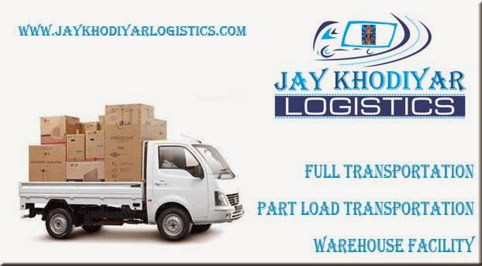
Our Services

Slide 4

Full Transportation
Pickup
Loading
Unloading
Transportation
Door Delivery

Slide 5
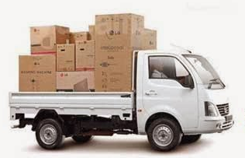
Part Load Transportation
Pickup
Loading
Unloading
Transportation
Door Delivery

Slide 6
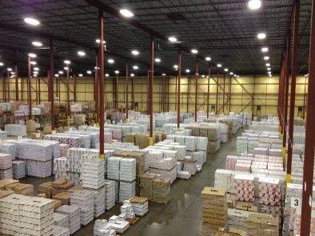
Distribution
Order Fulfillment
Full Pallet
Pick & Pack
Reverse Logistics
Material Handling
Assembly/Distribution
Third Party Logistics

Slide 7
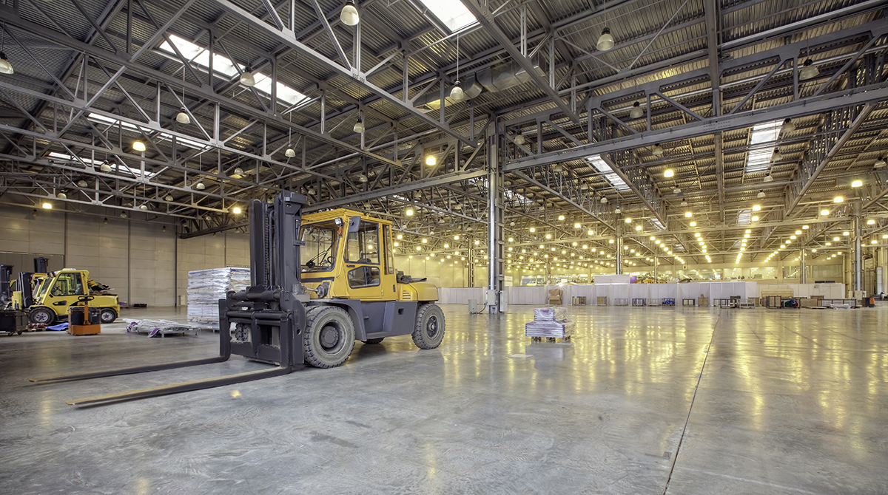
Warehouse Facility
Inward
Outward
Inventory
Stock maintain
Material Deliver

Slide 8

Why Jay Khodiyar ?
Single Source Provider
Customized Flexibility
Quality Assurance Program
Cost Effective Service
Secure & Safe
24 Hour Service Capability
Live Tracking of all Vehicles
Working this this Industry since last 14 years

Slide 9









Our satisfied Clients

Slide 10
Gallery

Slide 11
Testimonials

Slide 12
Contact Us
Office Address:
Jay Khodiyar Logistics
BG-2 Radhe Business Empire,
Opp. HP Pump, Aslali Sardar Patel Ring Road,
Aslali, Ahmedabad.
Email: info@jaykhodiyarlogistics.com
keyur.jaykhodiyar@gmail.com
pranav.jaykhodiyar@gmail.com
Web: www.jaykhodiyarlogistics.com
Keyur Patel : +91 99250 63271
+91 98980 32751
Pranav Vaishnav : +91 70466 63271
Office : 0218 297068

Slide 13


